Slide 1
SPARK & Nifi Training KeTSA

Slide 2

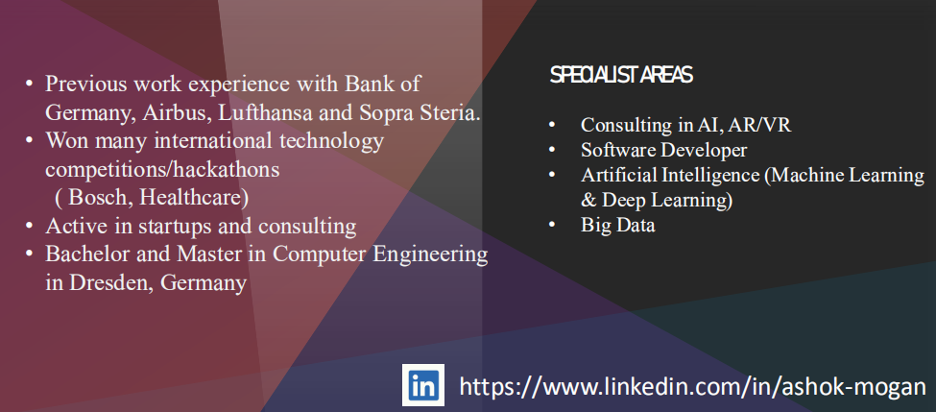
About Me

Slide 3
Agenda
What is Big Data
Hadoop Concept
What is Apache Spark and the architecture
Spark Hands-On Training
What is dataflow?
Introduction to NiFi
Components in NiFi
NiFi Hands-On Training

Slide 4
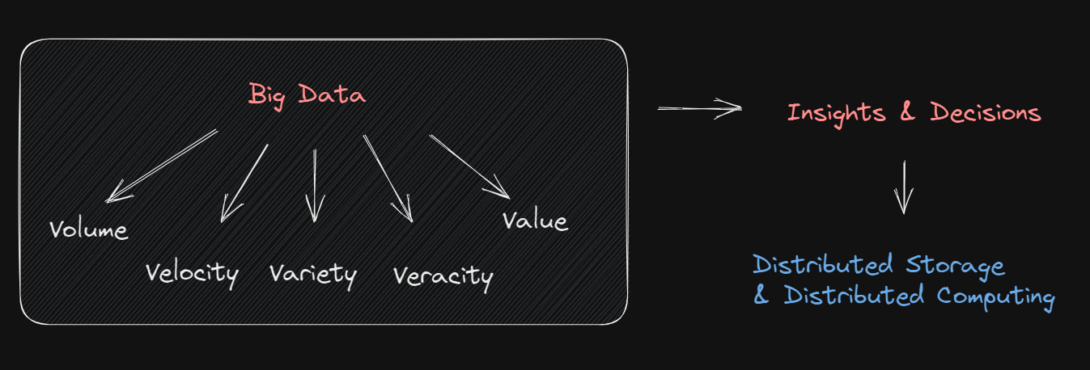
What is Big Data
Notes:
OLAP & OLTP
Batch and real-time processing

Slide 5
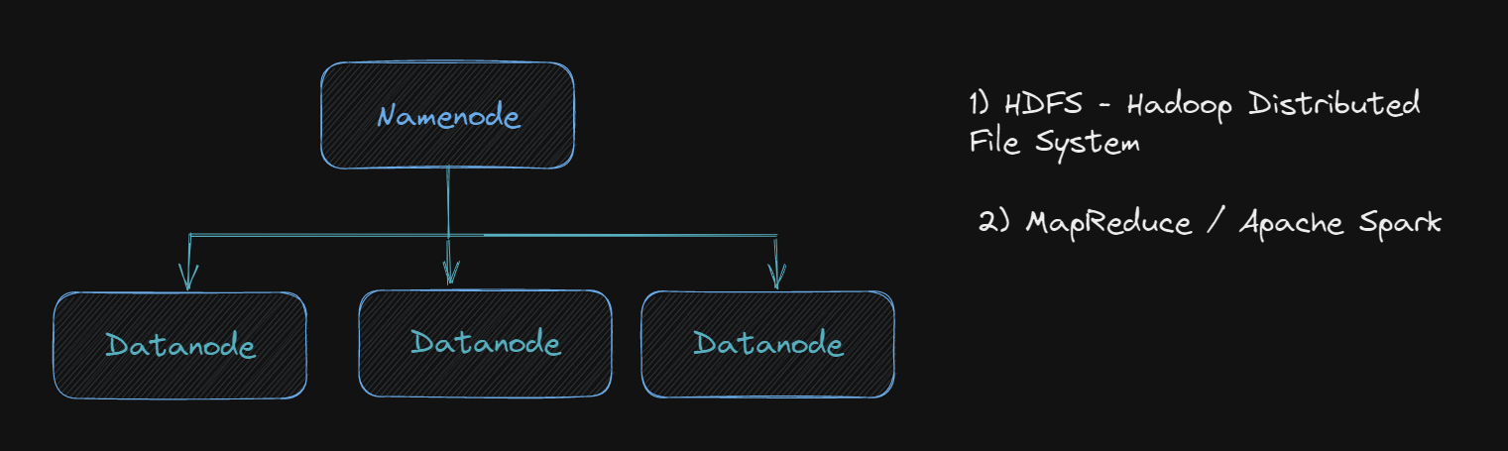
Hadoop Concept
Notes:
-fault tolerance
-each block size of 128mb replicated

Slide 6
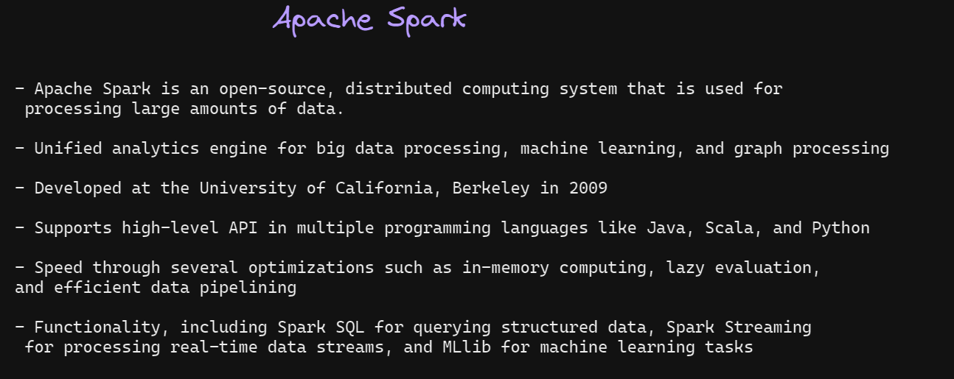
What is Apache Spark

Slide 7
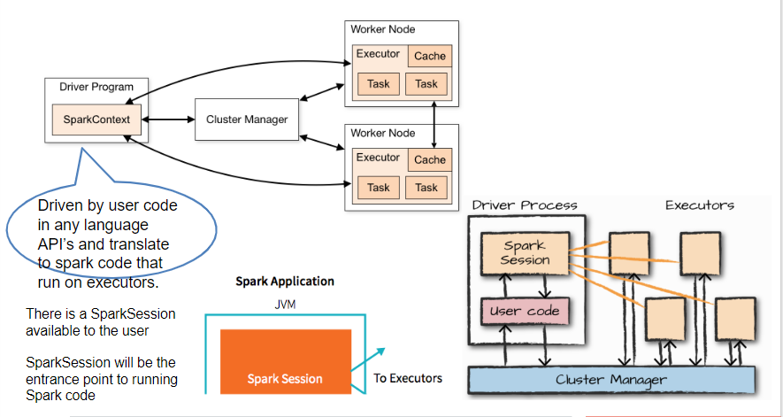
Apache Spark Architecture

Slide 8
Spark Hands-On KeTSA

Slide 9

NiFi?

Slide 10
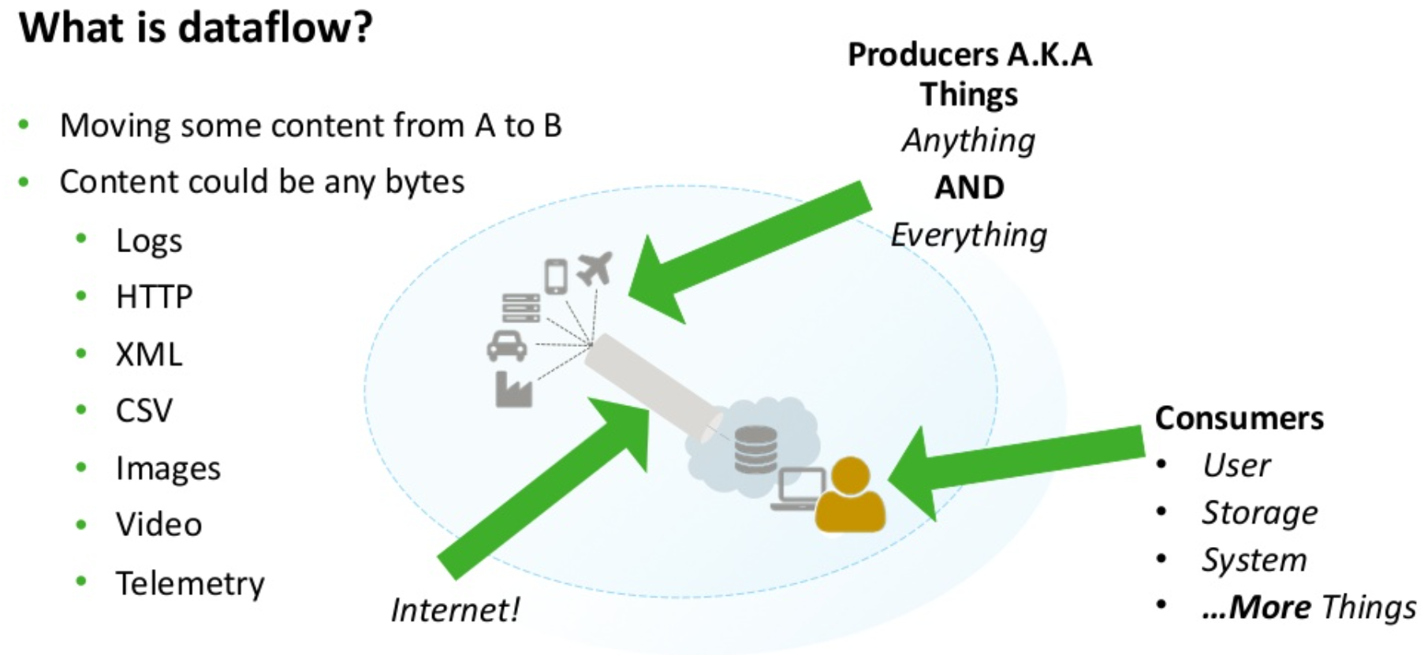

Slide 11
Transferring Data from one point to another is easy?
Bash/Ruby/Python
SQL
Copy & Paste
Database
Log files
Directory

Slide 12
Is it scalable?

Slide 13
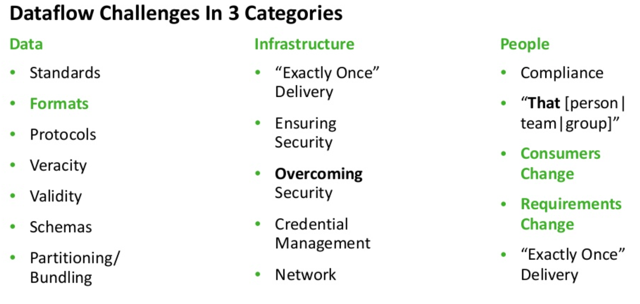

Slide 14
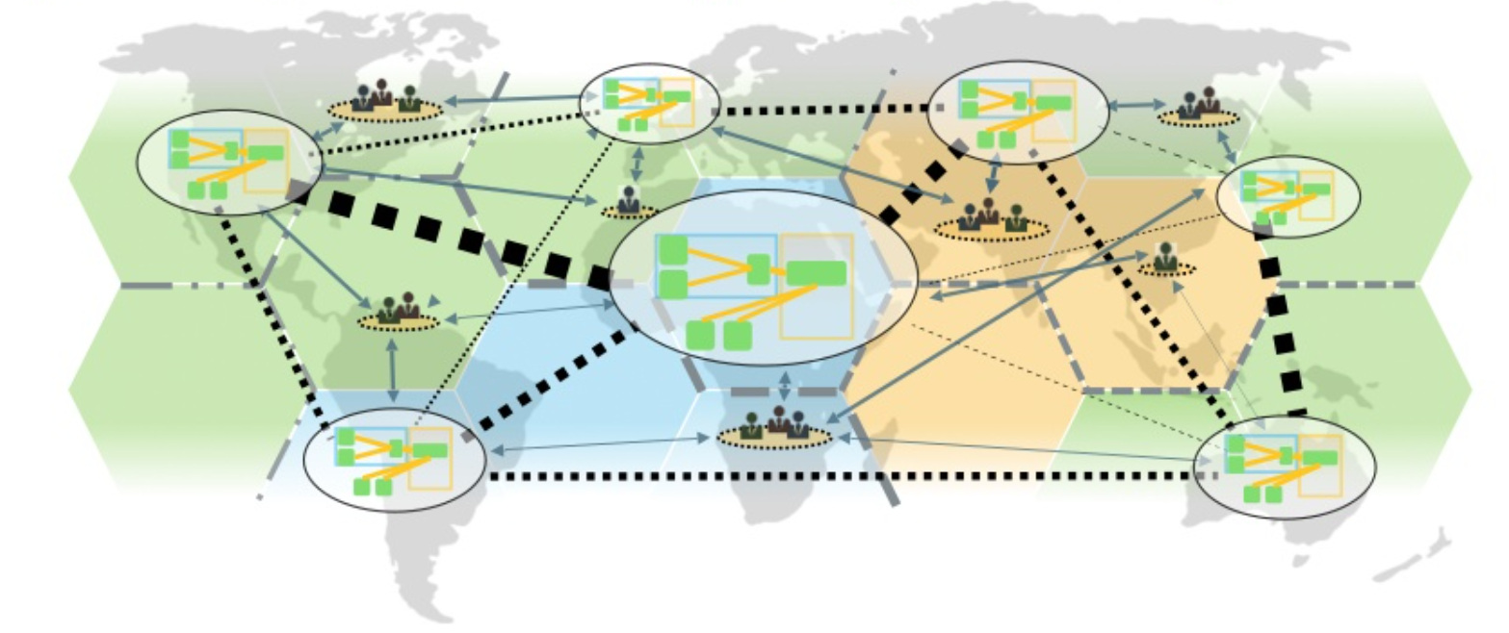
How are we going maintain this dataflow?

Slide 15
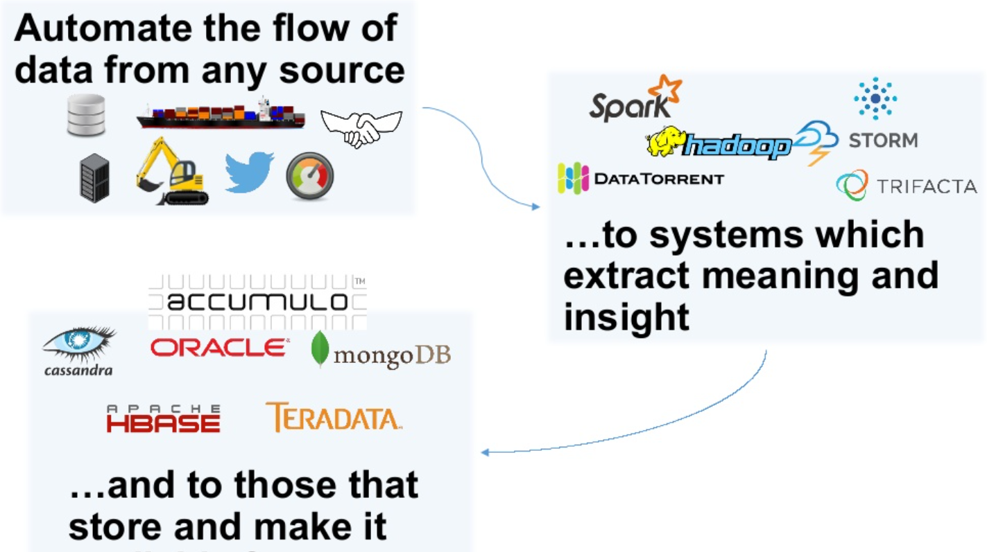

Slide 16
What is Apache NiFi?
“An easy to use, powerful, and reliable system to process and distribute data.”

Slide 17
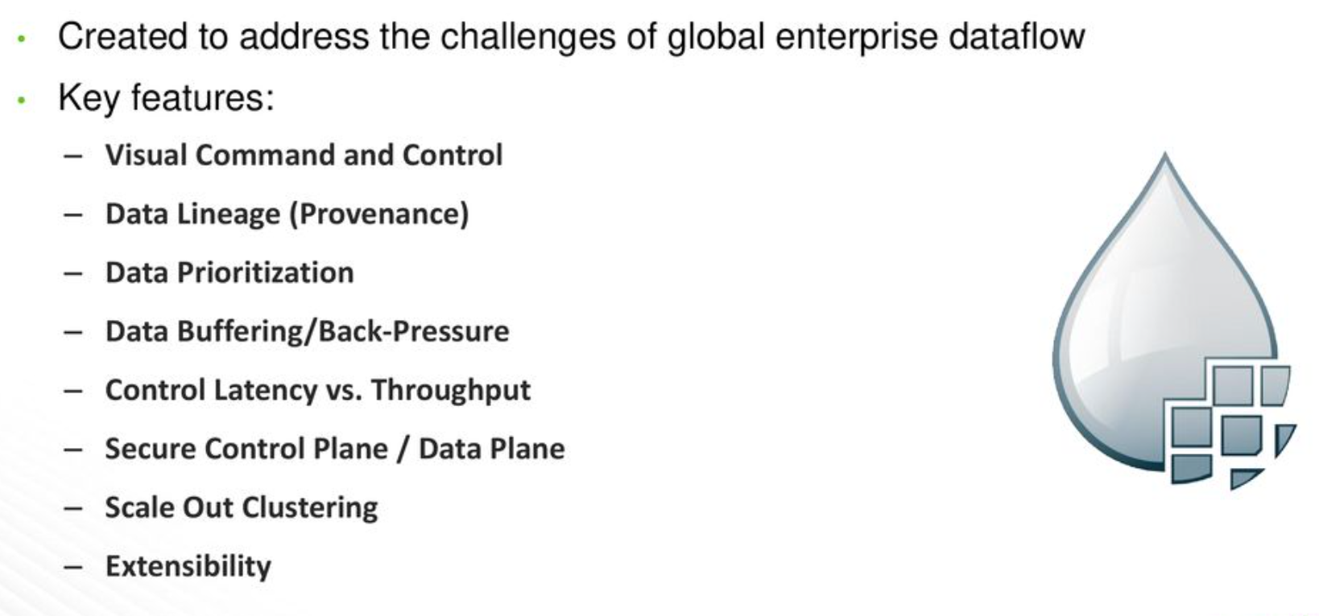
Apache NiFi

Slide 18
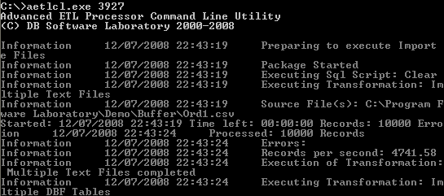
User Interface for Dataflow(previously)

Slide 19
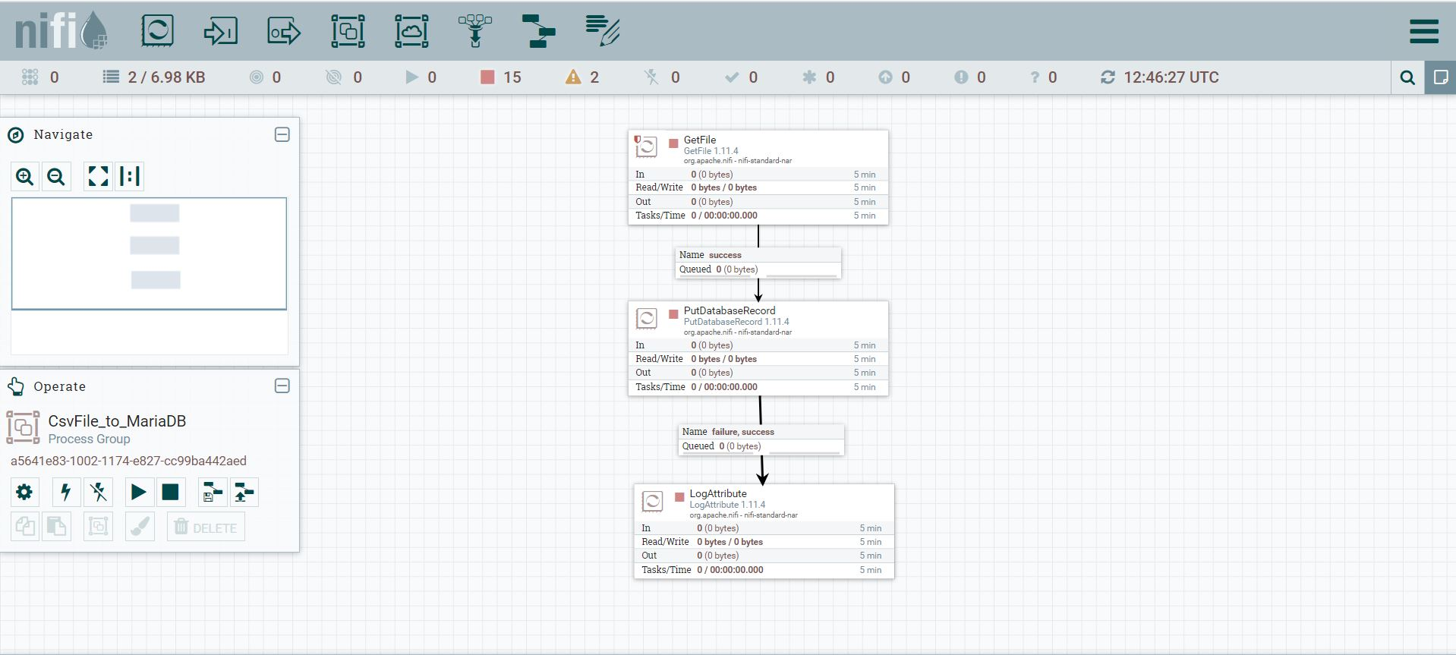
NiFi User Interface

Slide 20
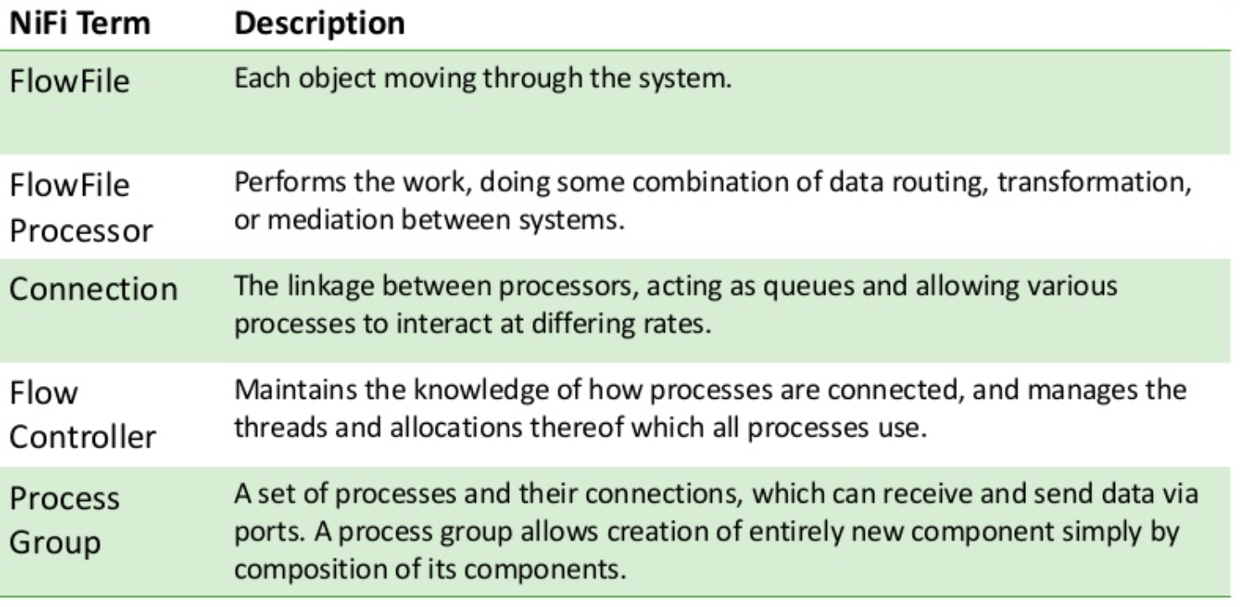
NiFi Components

Slide 21
NiFi Hands-On KeTSA

